Slide 1

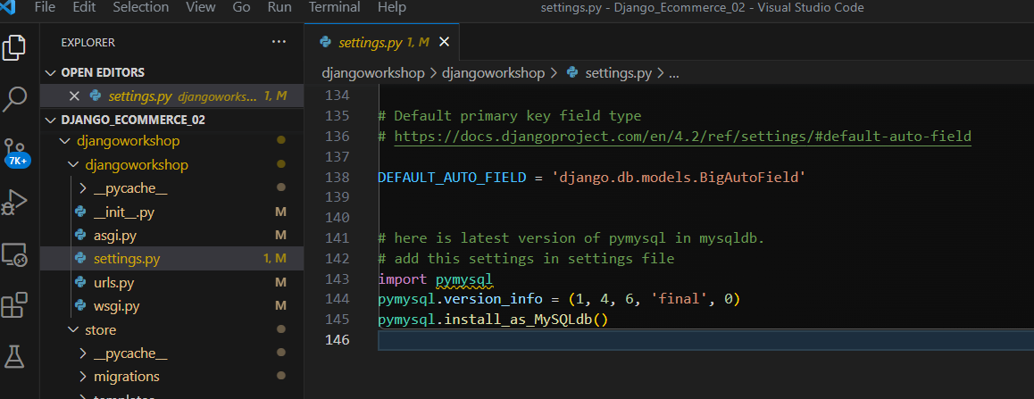
This project run on Dell Computer / Need open Xampp also
The Project run on Dell notebook ( Aug-12-2023)
Database name is Chaison
Found Problem can not see

Slide 2
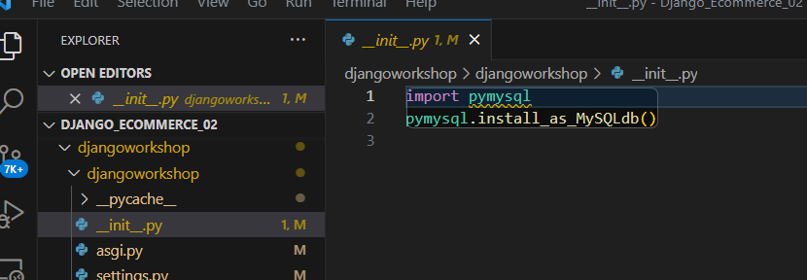

Slide 3
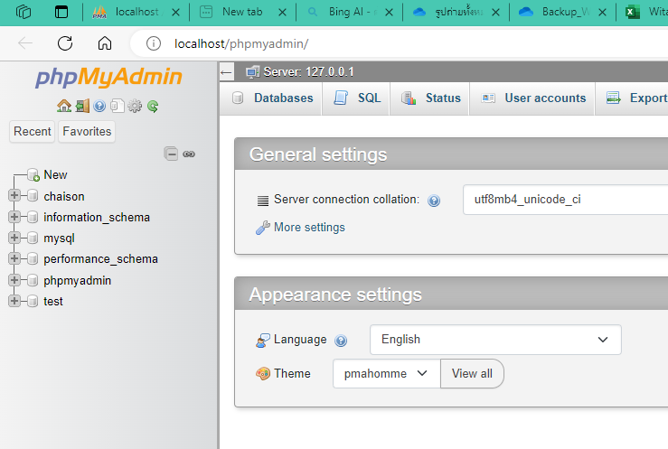

Slide 4
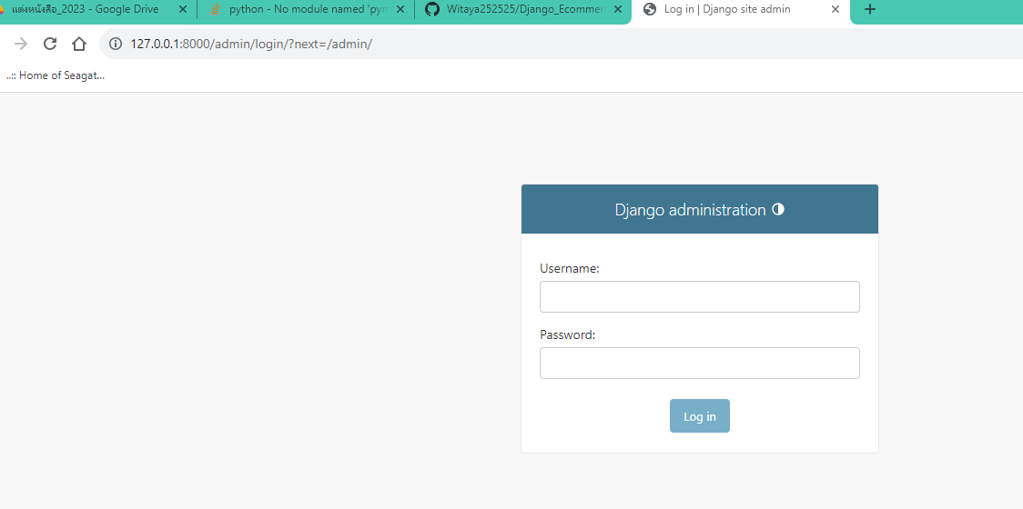
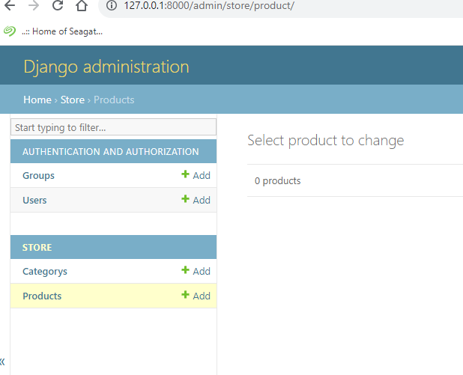
Witaya
339073

Slide 5
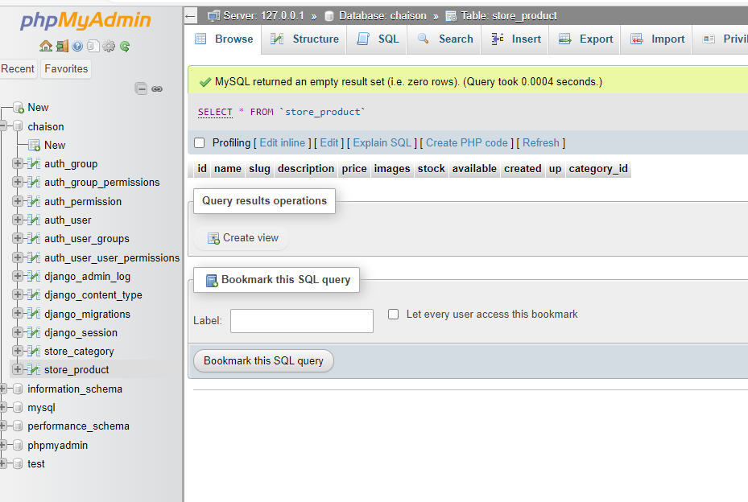

Slide 6
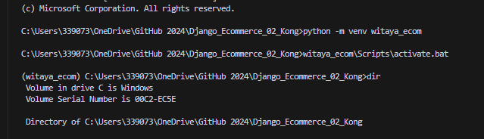
Microsoft Windows [Version 10.0.19045.3208]
(c) Microsoft Corporation. All rights reserved.
C:\Users\339073\OneDrive\WEBDEVELOP2023\Django_Ecommerce_02>python -m venv witaya_ecom
C:\Users\339073\OneDrive\WEBDEVELOP2023\Django_Ecommerce_02>witaya_ecom\Scripts\activate.bat
(witaya_ecom) C:\Users\339073\OneDrive\WEBDEVELOP2023\Django_Ecommerce_02\djangoworkshop>
อย่าลืม เปิด XAMPP ก่อน activate d-jango นะครับ ➔ Jan_08

Slide 7
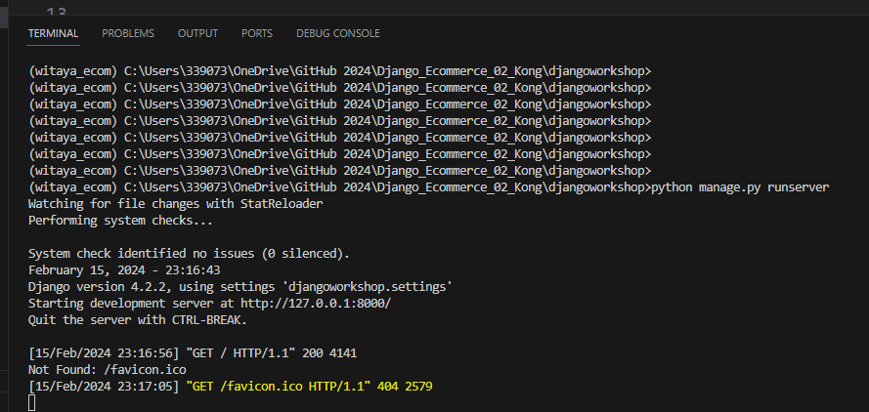

Slide 8
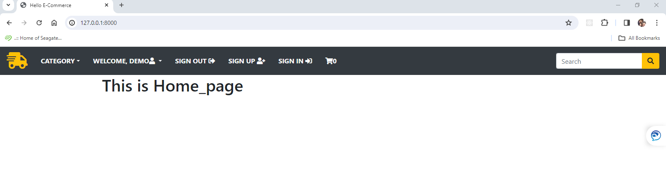
Feb_16_2024
Declare template [os.path,join(BASE_DIR,’templates’] and register app store
Layout.html + CDN popper , Bootstrap + jQuery at script , index.html ( {% extends “layout.html” %}

Slide 9
Create model
Create category is object
def__str__(self):
return self.name
1.How to upload picture to django
2.https://www.youtube.com/@LegionScript
3.Deply static on Root directory
4.Deploy Project on Project Folder
5. Lung upload image ==> https://www.youtube.com/watch?v=rRVWQCpZ_CI&t=15214s
6.How to create imapfe gallory in Django

Slide 10
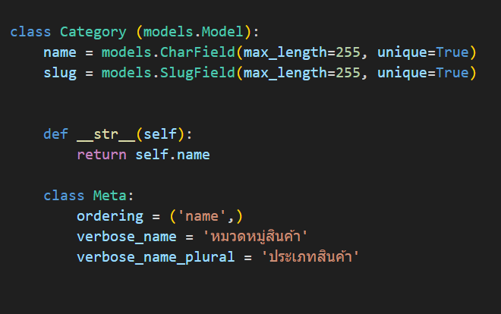
Class Meta:
Ordering = “ name”
verbose_name = “หวดหมู่.
Verbose_name_plural = ประเภทสินค้า
Create category is object
def__str__(self):
return self.name

Slide 11
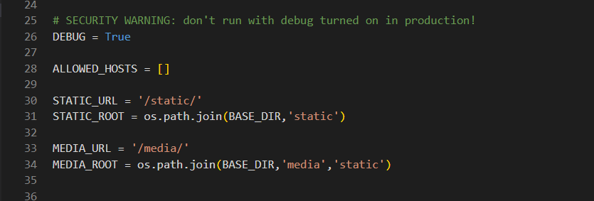
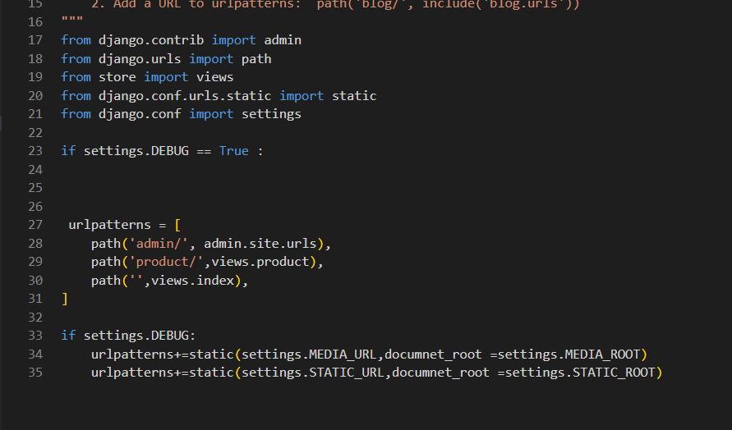
การกำหนดค่า การ upload ภาพ // กำหนดตัวแปล // กำหนด URL // กำหนดการ debug is True when developt //
March_28

Slide 12
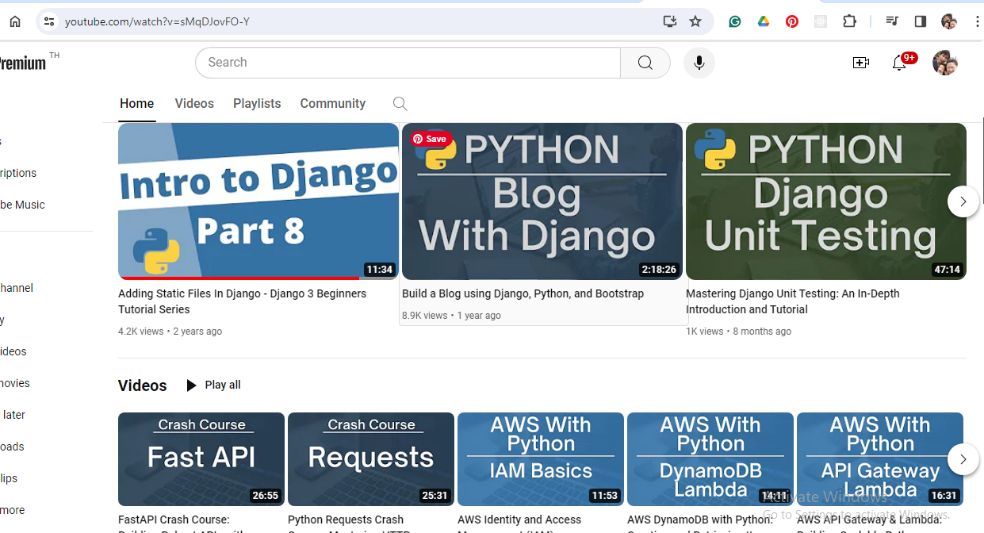

Slide 13
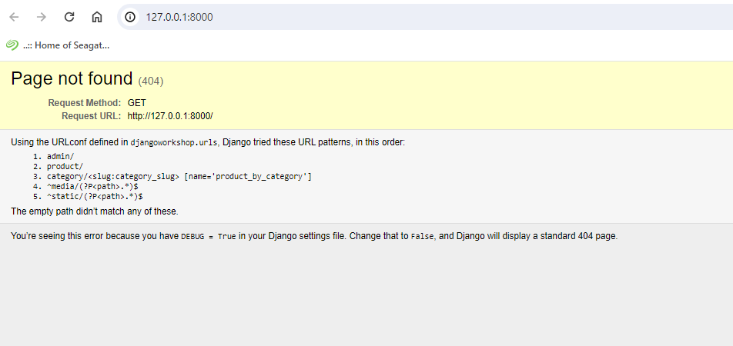
< div class = “ row my-3”

